Slide 1
CouchDB
Presented By:
Rosheen Asif
Muqadas
Aqsa

Slide 2
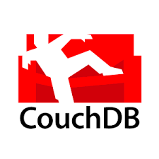
What is CouchDB?
CouchDB is clustered database that allows you to run a single logical database server on any number of server or vms.

Slide 3
Overview
Couchdb was introduced in 2005 but later become an apache software foundation project in 2008
Couchdb uses schema free data model
Couchdb is a Document Stoage NonSQL database
Data is in flexible Document based structure so there is no need to worry about structure of data (structured and unstructured)
Couch db facilitate users with powerful data mapping which allows querying combining and filtering the information

Slide 4
FEATURES
…………

Slide 5

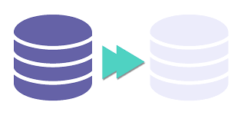


Features OF CouchDB
Easy
CouchDB Replication
CouchDB Views
Restful Api

Slide 6
Distributed Architecture with Replication
ACID Semantics
CouchDB provides ACID semantics.[11] It does this by implementing a form of Multi-Version Concurrency Control, meaning that CouchDB can handle a high volume of concurrent readers and writers without conflict.
CouchDB was designed with bi-directional replication (or synchronization) and off-line operation in mind. That means multiple replicas can have their own copies of the same data, modify it, and then sync those changes at a later time.

Slide 7

Document Storage
CouchDB stores data as "documents", as one or more field/value pairs expressed as JSON. Field values can be simple things like strings, numbers, or dates; but ordered lists and associative arrays can also be used. Every document in a CouchDB database has a unique id and there is no required document schema.

Slide 8
MapReduce Views
The stored data is structured using views. In CouchDB, each view is constructed by a JavaScript function that acts as the Map half of a map/reduce operation. The function takes a document and transforms it into a single value that it returns. CouchDB can index views and keep those indexes updated as documents are added, removed, or updated.

Slide 9

HTTP API
All items have a unique URI that gets exposed via HTTP. It uses the HTTP methods POST, GET, PUT and DELETE for the four basic CRUD (Create, Read, Update, Delete) operations on all resources.

Slide 10
Advantages
Document model: it is easy to serialize objects to JSON store them retrieve and deserialize when we needed them back
No readlocks: if you ever need to update or modify a table the row of data being changed becomes locked to other users until the modification request is processed
CouchDB is open source, project, supported and developed by a community of contributors.
Scalable : the architectural design of couchdb makes it extremely adaptable when partitioning dbs and scaling data into multiple nodes

Slide 11
Disadvantages
Performance Issues
High Disk and Memory Usage:
MapReduce Complexity:
CouchDB can be slow for writing and querying large datasets because of its append-only storage and the need for proper indexing and complex view design.
The append-only storage model leads to high disk space usage due to document revisions, necessitating periodic compaction. Large databases and views also consume significant memory
Designing and implementing MapReduce views requires a good understanding of JavaScript and the MapReduce paradigm, presenting a significant learning curve.

Slide 12
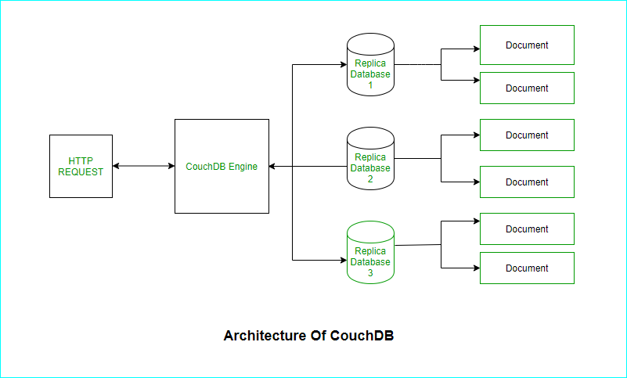
How CouchDB Works?

Slide 13
CouchDB vs. MongoDB
Data Model:
CouchDB: Document-oriented, uses JSON for document storage.
MongoDB: Document-oriented, also uses BSON (binary JSON) for document storage.
Replication and Sharding:
CouchDB: Supports master-master replication, making it highly available and suitable for offline-first applications.

Slide 14
MongoDB: Supports master-slave replication and sharding for horizontal scaling.
Query Language:
CouchDB: Uses MapReduce for querying and has a limited query language.
MongoDB: Uses a rich query language that supports complex queries, indexing, and aggregation.
APIs:
CouchDB: Provides a RESTful HTTP API.
MongoDB: Provides drivers for various programming languages and a rich query API.

Slide 15
APPLICATIONS
…………

Slide 16
Mobile Applications: Cloudant Sync (IBM)
Application: Offline-First Mobile Applications
Organization: IBM (Cloudant Sync)
How CouchDB is Used: Cloudant Sync, built on CouchDB, enables mobile applications to function offline by allowing data to be stored locally on the device and synchronized with the cloud when the device is back online. This is particularly useful for applications used in areas with poor connectivity or by mobile workforces.

Slide 17
Healthcare: Medbook
Application: Patient Health Records Management
Organization: Medbook
How CouchDB is Used: Medbook utilizes CouchDB to store and manage patient health records. This ensures that healthcare providers can access patient data across multiple locations and maintain continuity of care even in areas with unreliable internet connectivity. CouchDB’s replication feature allows seamless data synchronization once connectivity is restored.

Slide 18
DEMO VIDEO

Slide 19
